Slide 1

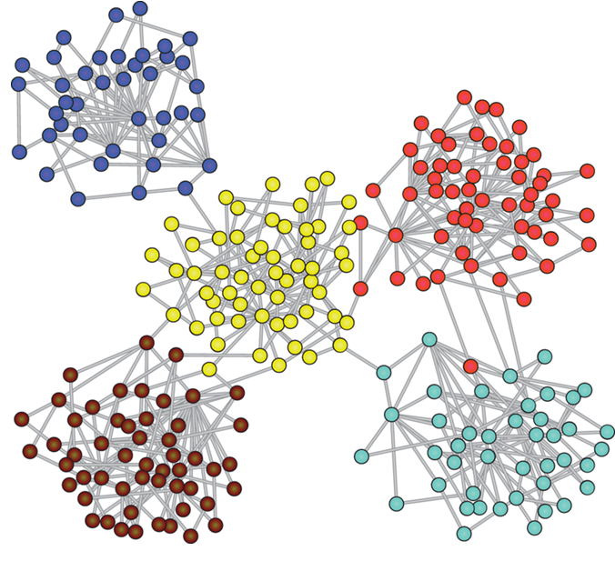
Capstone Project Phase A: Graph Generation using Graph U-Nets 24-1-R-4
Yana Raitsin | Hanil Zarbailov
Supervisor: Dr. Renata Avros

Slide 2
Agenda
Project's Goals
Project’s Components
Graph U-Nets
Misc-GAN
Project Solution

Slide 3
Project's Goals: The Problem
The Problem with the Misc-GAN model:
Does not use node features for generating synthetic graphs.
Has limitations in graph generation precision.

Slide 4
Project's Goals: Need For The Project
To Propose a new approach based on Graph U-Nets.
To improve upon Misc-GAN's efficiency and precision.
To accurate graph generation upon given prototypes.

Slide 5
Project’s Components
This project includes the following components:
Training of a Graph U-Net on a given underlying source graph.
Coarsening graphs on different hierarchal levels.
Integrate Graph U-Net into Misc-GAN.
Cycle-GAN.

Slide 6
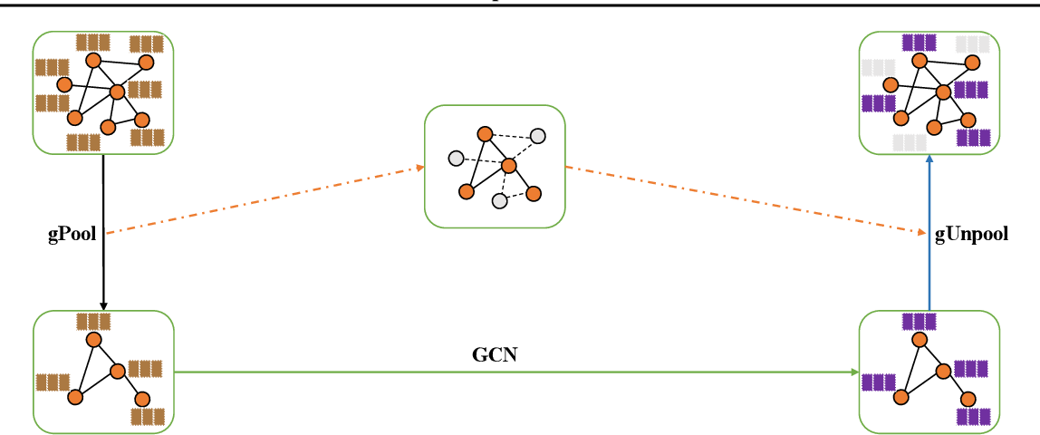
Graph U-Nets
An adaption of U-Net architecture for graph-structured data.
Key Components:
Graph Convolutional Layers: Perform convolution operations on graphs to capture local structures.
Pooling and Unpooling Layers: Coarsen and reconstruct graphs, preserving essential structures.
Skip Connections: Retain important features and improve gradient flow by connecting downsampling and upsampling paths.

Slide 7
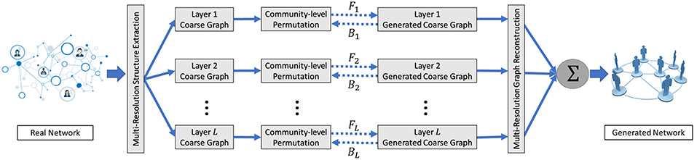
Misc-GAN
Sophisticated graph generation model – referencing model.
Captures complex relationships and hierarchies.
The architecture:
Multi-Scale Graph Representation Module.
Graph Generation Module.
Graph Reconstruction Module.

Slide 8
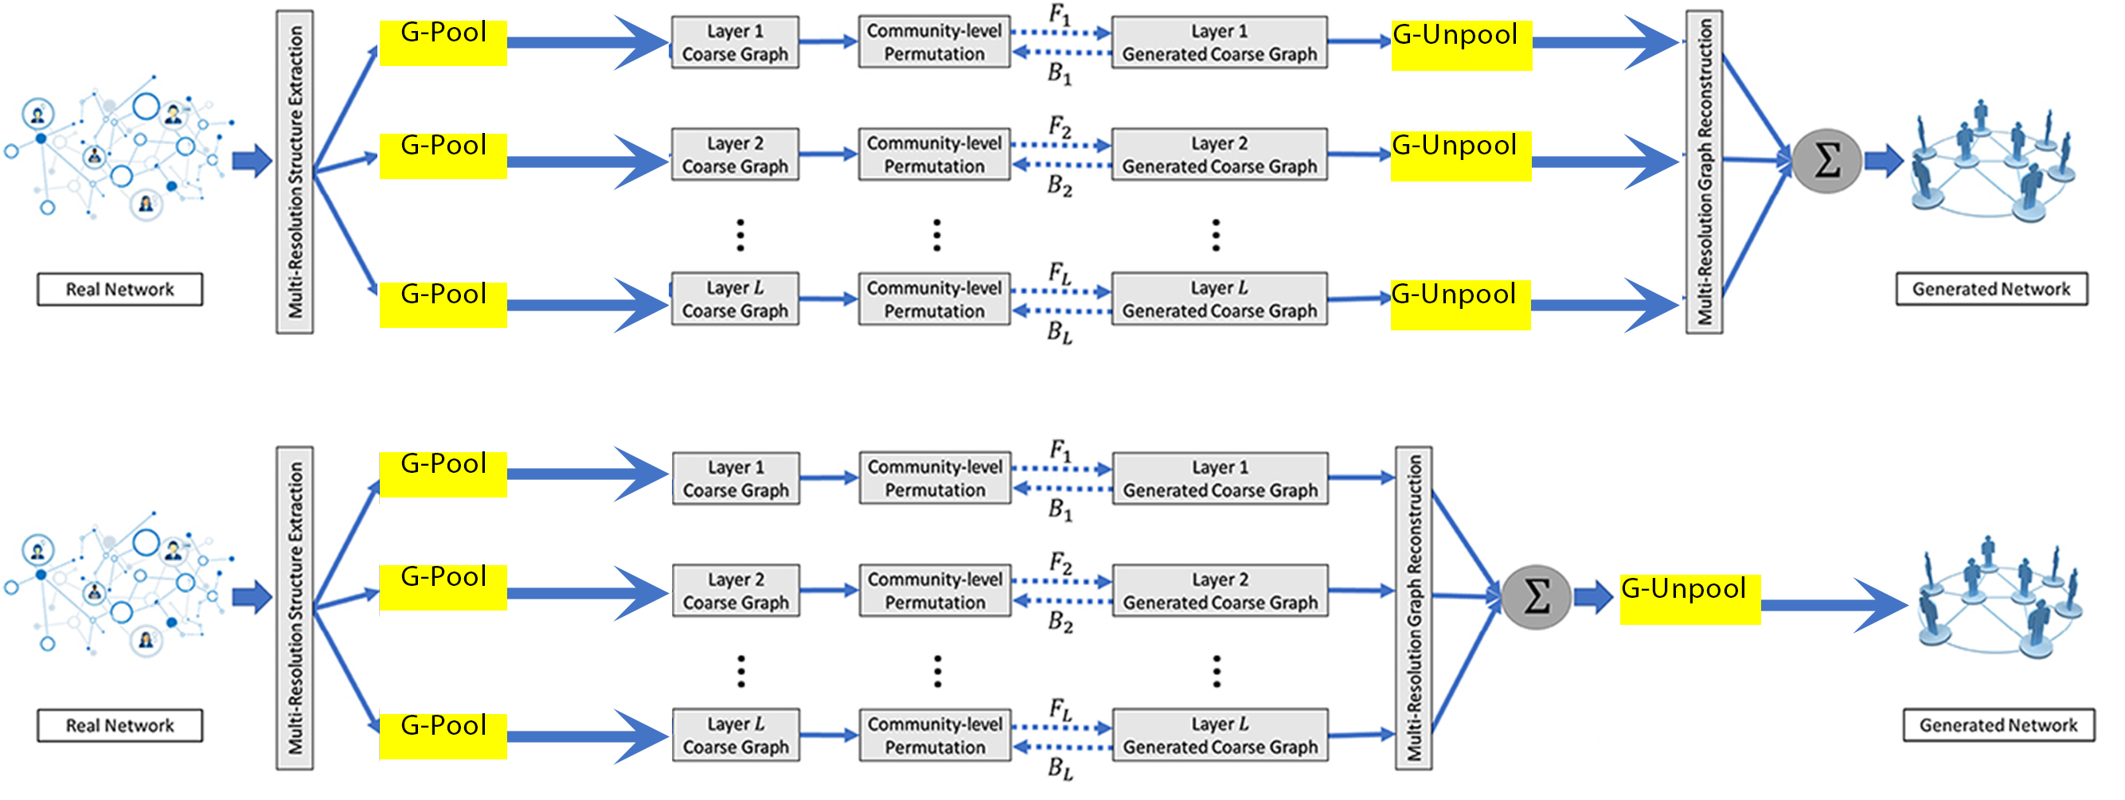
Project Solution: Architecture

Slide 9
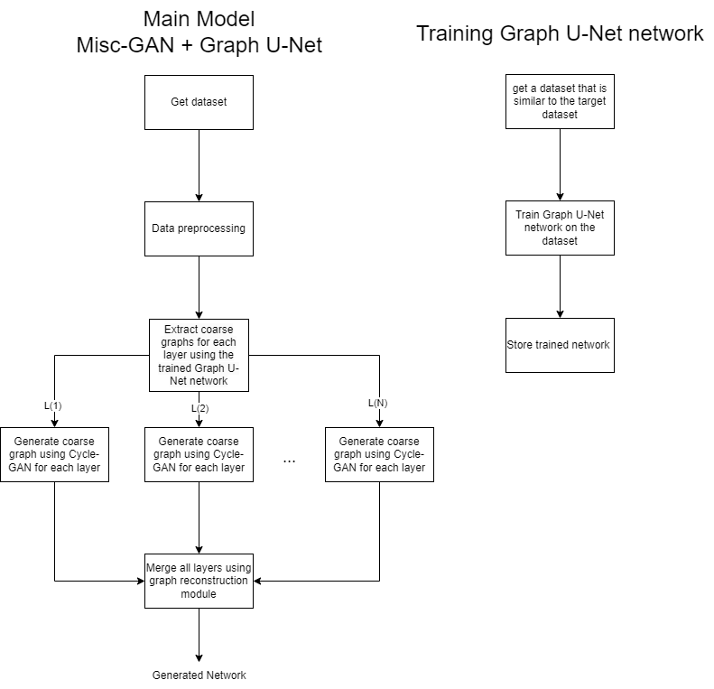
Project Solution: Training A Graph U-Net
Choose underlying source graph.
Train the Graph U-Net module on the chosen graph.
Store the network in order to use it in the improved Misc-GAN.

Slide 10
Project Solution: Preprocessing
Clean and extract relevant data from the given dataset.
Includes:
Removing lone nodes from the graph.
Adjacency matrix.
DBSCAN.
AMG.

Slide 11
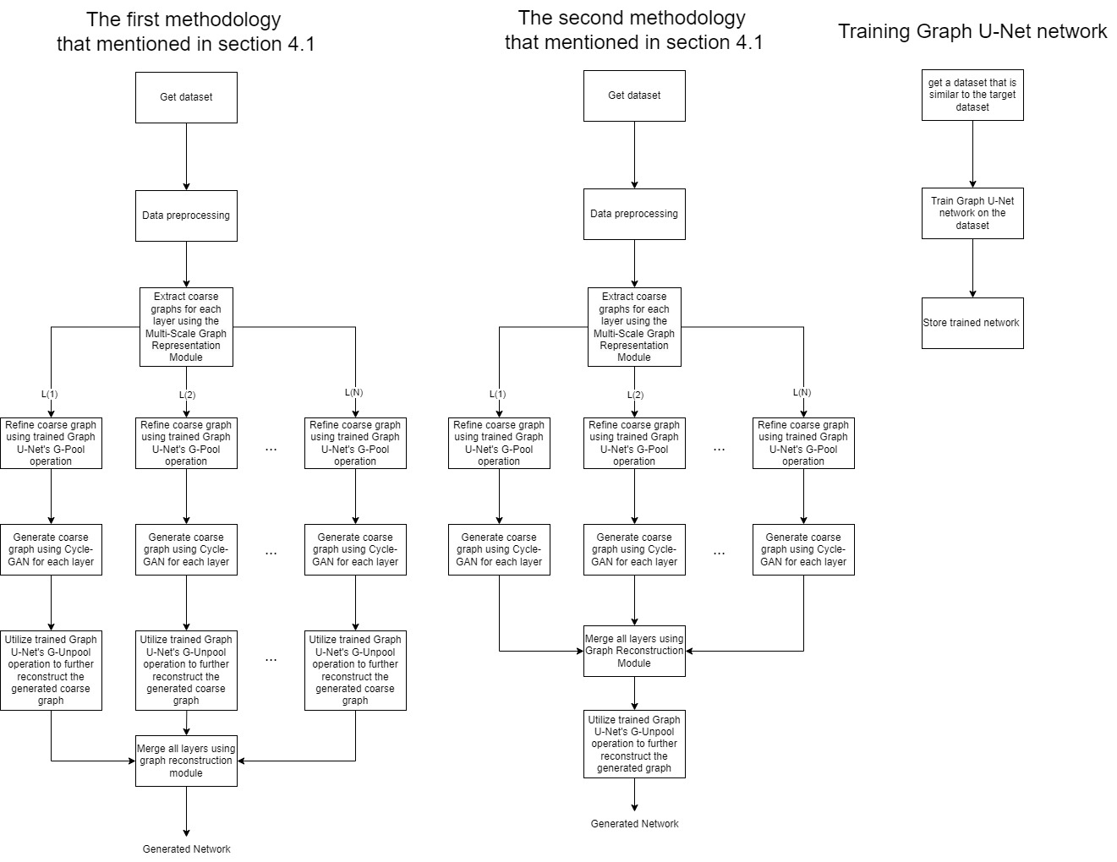
Project Solution: Extracting Coarse Graphs
Extracting Coarse Graphs by using the Multi-Scale Graph Representation Module.
Refine coarse graphs using trained Graph U-Net's G-Pool operation.
Maintains graph structural integrity after extraction.
Enhance Coarse graph extraction on node features.

Slide 12
Cycle-Gan
Uses the concept of GAN but duplicated.
Have 2 discriminators and 2 generators one for each domain.
Achieves more consistent results and better mapping.

Slide 13
Project Solution: Generate coarse graphs of each layer
Base graph generation on coarse graphs extracted from the last step.
Uses Cycle-GAN to generate synthetic coarse graphs at each granularity layer.
Coarse graph is source domain.
Synthetic coarse graph is the target domain.

Slide 14
Project Solution: Reconstructing the Final Network, First Method
Integrate trained Graph U-Net's G-Unpool operation for each generated coarse graph.
Merging all upscaled generated coarse graphs.
Reconstruct using linear function with weights and biases allowing users control over the significance of each layer.

Slide 15
Project Solution: Reconstructing the Final Network, Second Method
Merging all generated coarse graphs from the last phase.
Integrate trained Graph U-Net's G-Unpool operation on merged synthetic graph.

Slide 16
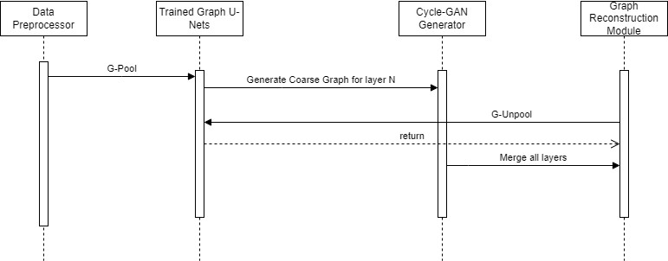
Main Model’s Sequence Diagram: First Method

Slide 17
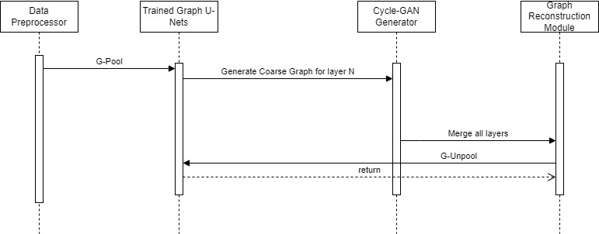
Main Model’s Sequence Diagram: Second Method

Slide 18
Verification Plan
Test Number | Test Subject | Expected Result
1 | args.which_stage = 'A' Instead of “training” or “testing”. | Our proposed model should throw an exception.
2 | Change dataset_A to a path that doesn’t exist. | Our proposed model should throw an exception while trying to load the data.
3 | Change starting_layer to be greater than the number of layers (parameter layer) | Our proposed model should throw an exception before starting to train.
4 | Change args.epoch = -10 | Our proposed model should throw an exception before starting to train.

Slide 19
Verification Plan
Test Number | Test Subject | Expected Result
5 | Run the model with the default arguments | Our proposed model should run with default values in the training and testing.
6. | args.gpu toggled between True and False | Our proposed model should verify GPU usage based on the given value.
7. | Generate synthetic network based on the given input | Our proposed model should match the expected network structure.
8. | Save all files in output directory using the args.filename input | Our proposed model should create the directories and save the files correctly.

Slide 20
Conclusions
The proposed solution aims to improve upon Misc-GAN's success.
Merging two innovative models together can cover the weaknesses of each one of them.
Giving Misc-GAN new capabilities by improving graph generation and simulation.

Slide 21
Thanks!
Any Questions?

